Slide 1
Where to open a Chinese restaurant in London?
Coursera Capstone Project

Slide 2
Content
Data preparation
Clustering methodology
Conclusion

Slide 3
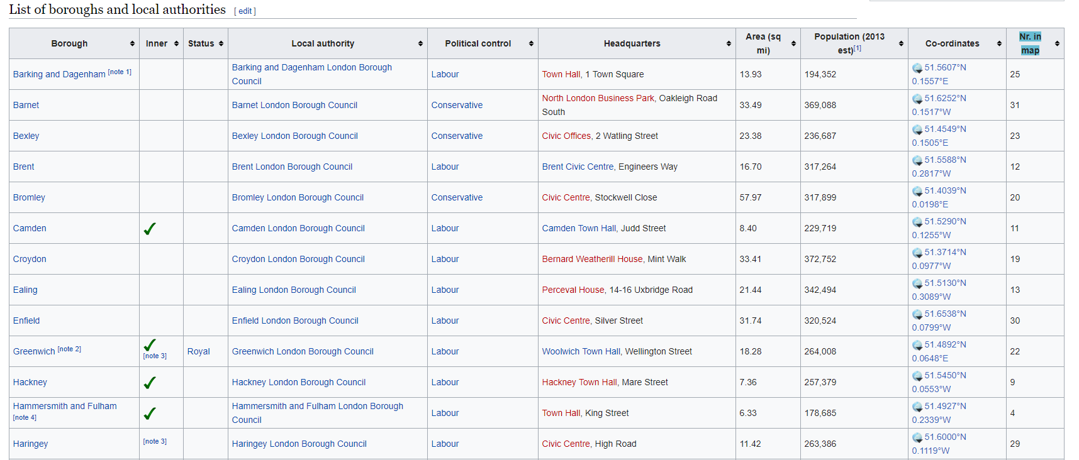
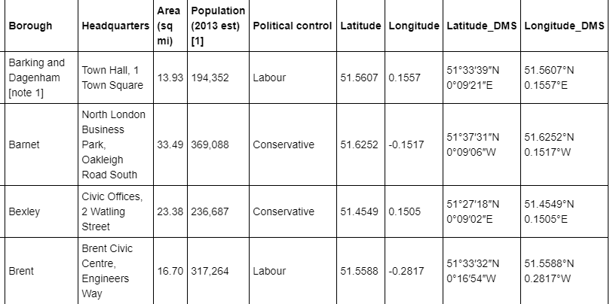
Data preparation – Source 1
Data of London boroughs: area size, population, geo-coordinates scrapped from Wikipedia
Web scrapping
Table on Wikipedia
Pandas data frame

Slide 4
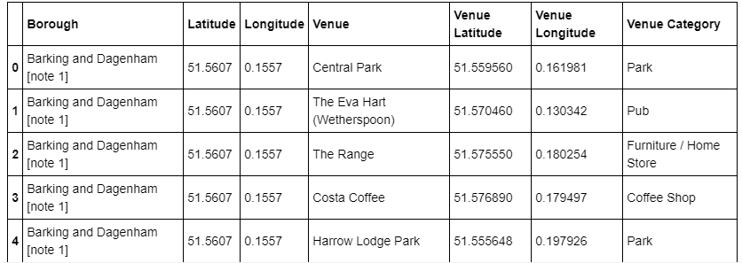
Data preparation – Source 2
London venue data from Foursquare: venue name, geo-coordinates, venue type
Sample venue data by borough

Slide 5
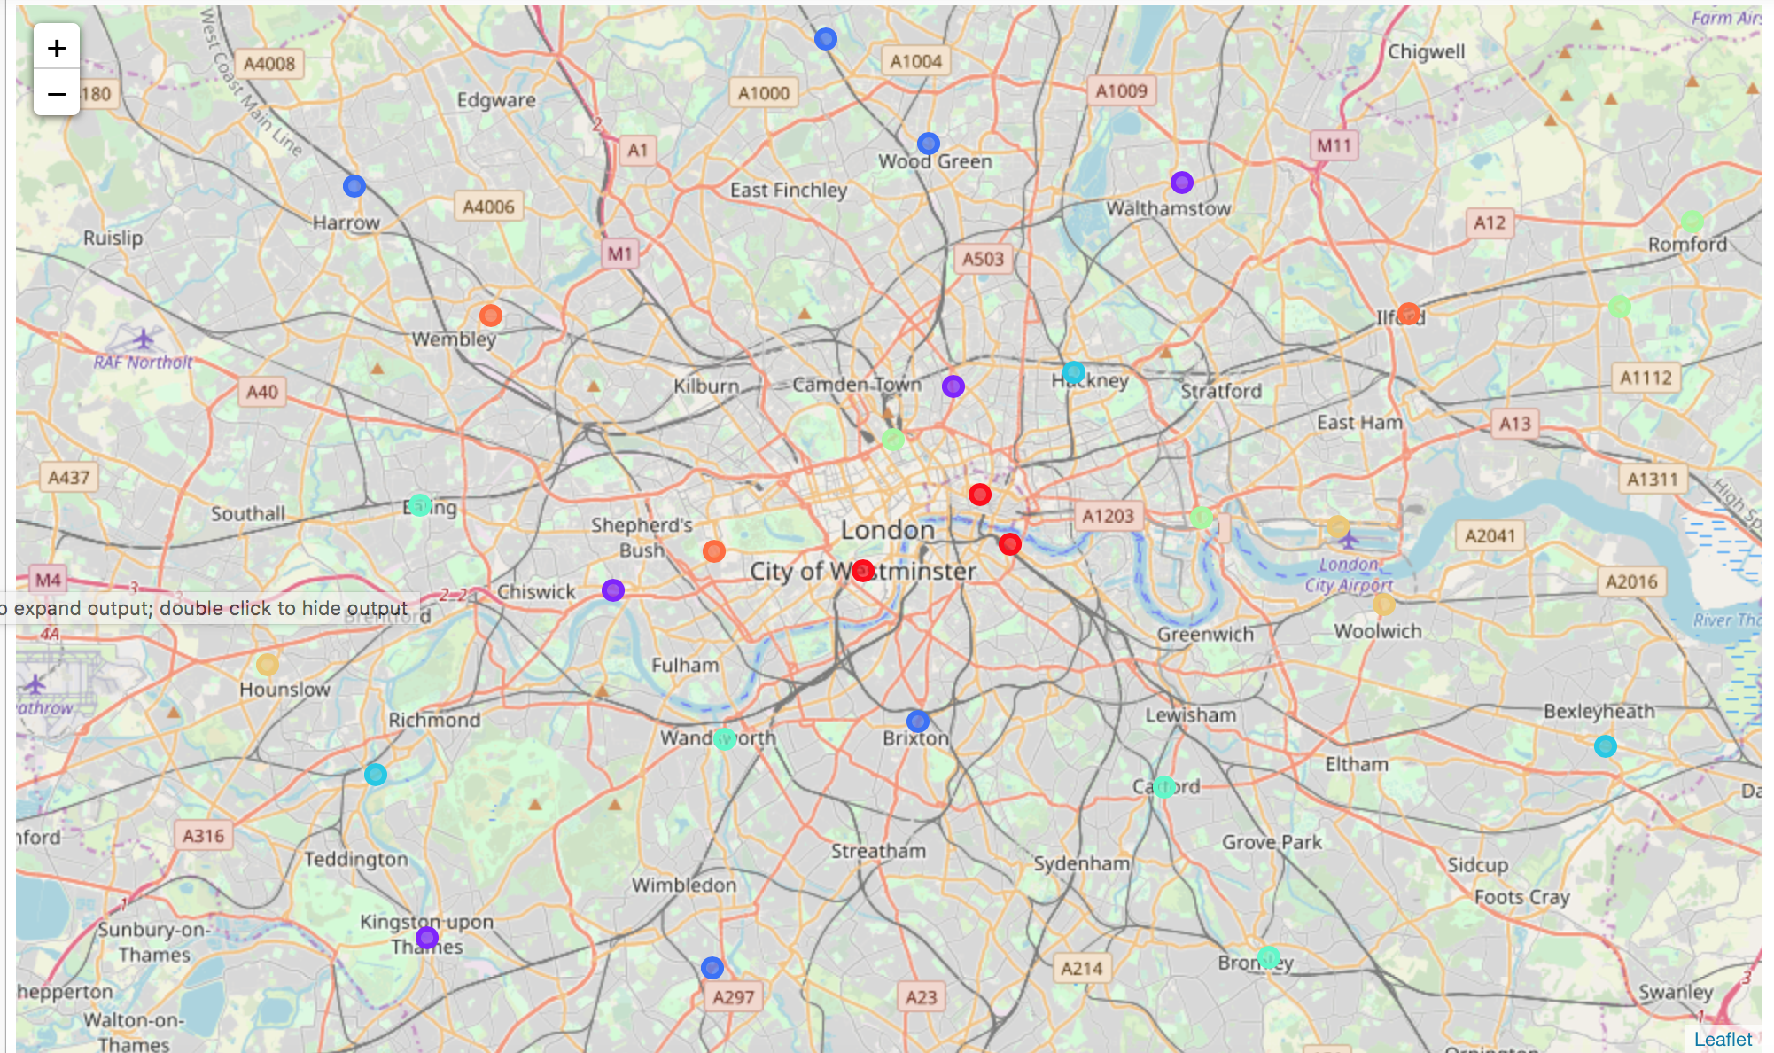
Clustering
Run K-means to cluster boroughs into 8 clusters

Slide 6
Clustering – Results analysis
Below attributes are desirable for opening a new Chinese restaurant:
Significant number of restaurants out of all venues
Ratio of existing Chinese restaurants out of all restaurants is relatively low
Large number of pubs
Large number of hotels
Relatively fewer gyms
Densely populated
Office presence

Slide 7
Conclusion
Cluster 0 has the most desirable attributes:
Relatively high number of restaurants
No Chinese restaurants
Plenty of pubs and hotels
Fewer gyms
Out of the 3 preferred boroughs in Cluster 0, Southwark is the most preferred because it is more densely populated than the other two boroughs.

